Slide 1
RRSP Campaign
Collateral:
Landing page
Banner ad
Emails
Social media posts – promoted and organic

Slide 2

RRSP Campaign
https://www.cdspi.com/graduationcountdown/
Landing page details (December 11, 2020 – April 21, 2021)
Pageviews: 196
Unique pageviews: 165
Avg. time on page: 00:01:15
Bounce rate: 81.82%
% exit: 51.02%

Slide 3

RRSP Campaign

Slide 4
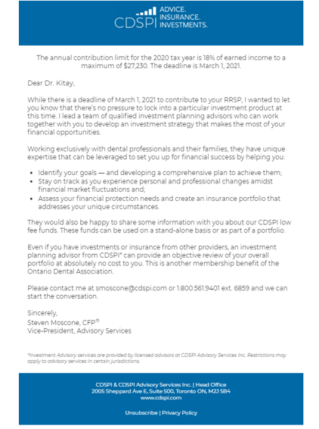
RRSP Campaign
Subject line: Make Your Move — Build your RRSP with CDSPI Funds
Total advisors: 8, across Canada, sent February 11, 2021, 1:00 pm
Total sent: 10,629
Total opens: 5,271
Total open rate: 49.59%
Total bounced: 314
Total unsubscribed: 21

Slide 5
RRSP Campaign
Advisor | Sent | Opens | Open rate | Bounced | Unsubscribed
Steven Moscone | 3,091 | 1,371 | 44.36% | 286 | 7
Jaye Walter | 1,116 | 583 | 52.24% | 6 | 1
Michael Tyler | 791 | 438 | 55.37% | 6 | 3
Shane Dewling | 509 | 236 | 46.37% | 1 | 1
Penny Hall | 1,505 | 788 | 52.36% | 3 | 2
Dana Scott | 991 | 470 | 47.43% | 6 | 2
Shiv Ghuman | 1,106 | 599 | 54.16% | 2 | 0
Brian Buirs | 1,520 | 786 | 51.71% | 4 | 4

Slide 6
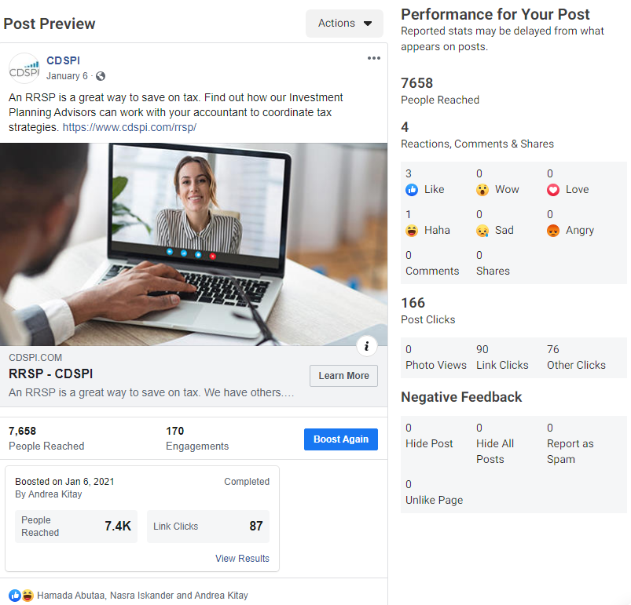
RRSP Campaign
Promoted post/ad details:
Status: completed
Goal: get more website visitors
Total budget: $50.00
Duration: 9 days
Start date: January 6, 2021
End date: January 15, 2021
Ad type: boosted post
Link clicks: 87
Reach: 7,433
Cost per link click: $0.57

Slide 7
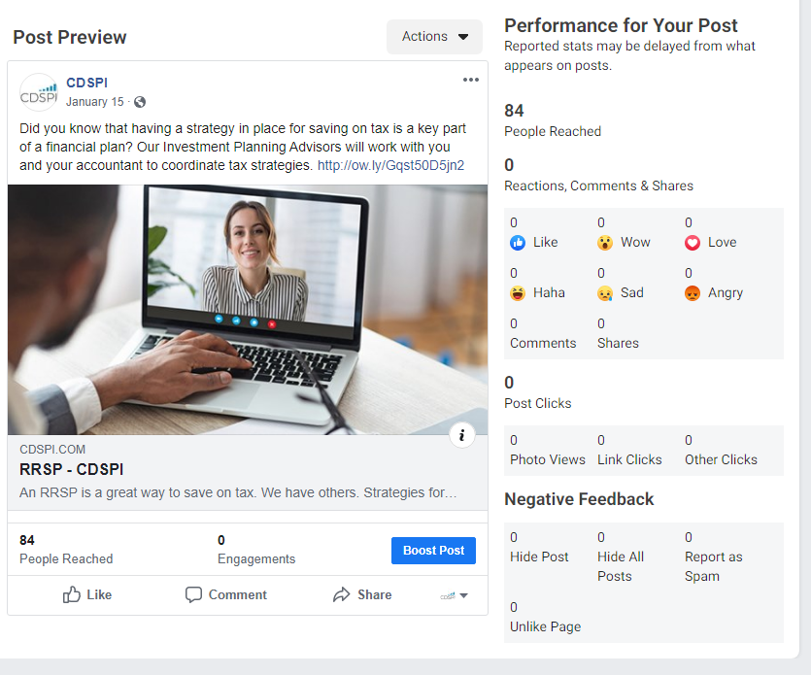
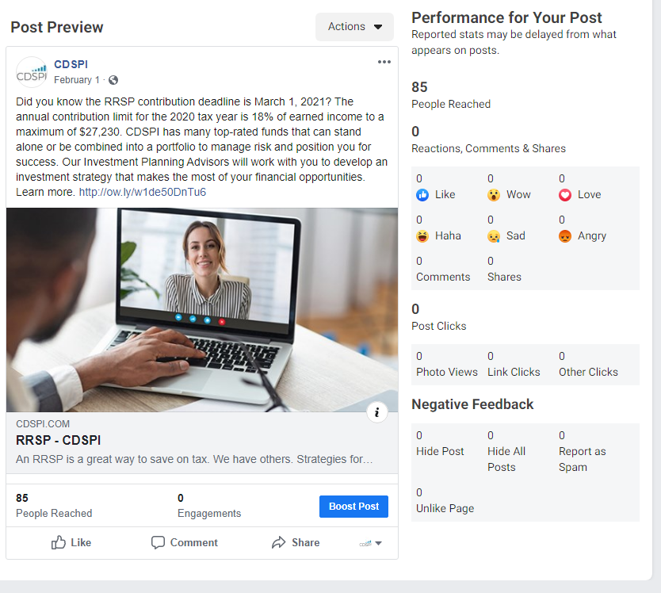
RRSP Campaign

Slide 8
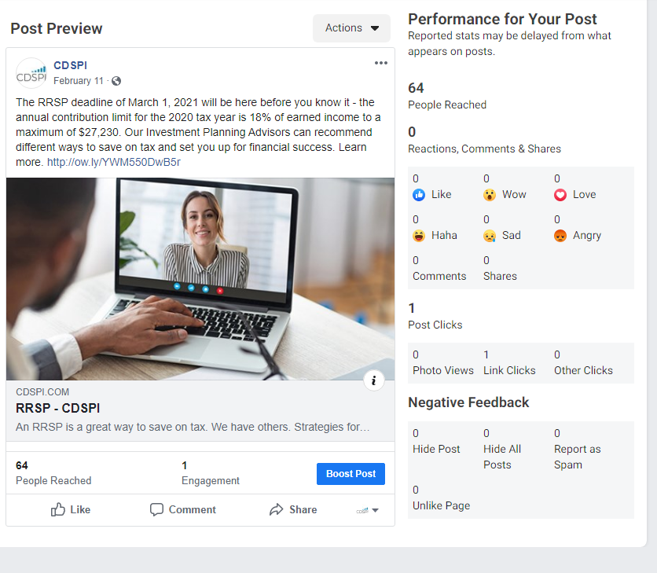
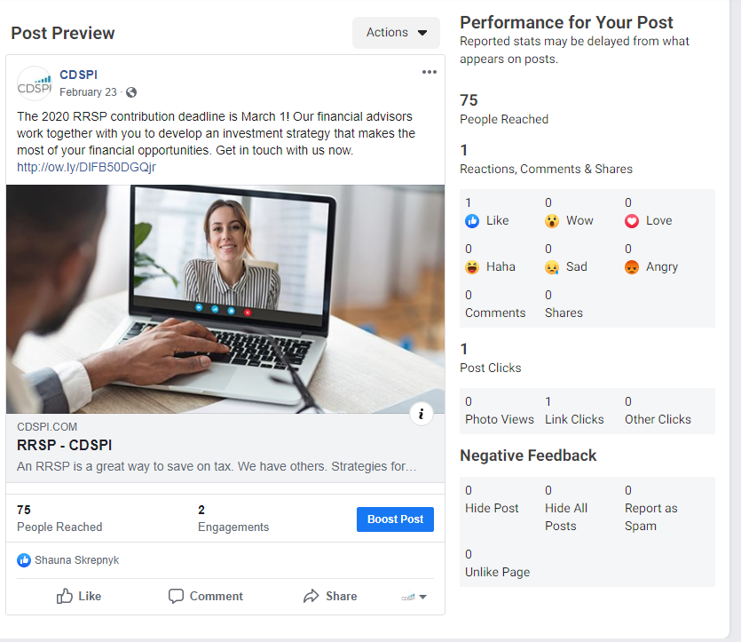
RRSP Campaign

